Slide 1
MODELING THE CONTROL OF BACTERIAL INFECTIONS VIA ANTIBIOTIC-INDUCED PROVIRUSES
Dawson Payne
Gabriel Hanson
Wisam Fares
Mackenzie Grubb
Notes:
Feedback - add limitations of model (what can’t it do)
As Sam commented, it would be interesting to look at how a skipped dosage effects the bacterial population, This is one of the most common types of complications that arise in antibiotic treatment

Slide 2
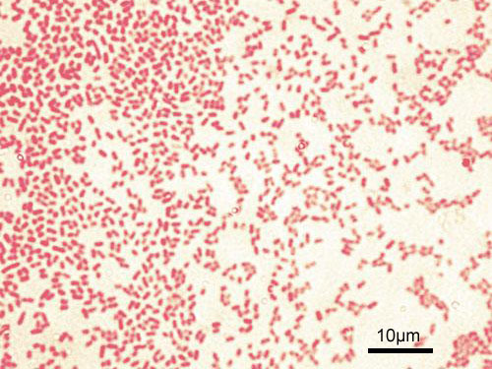
PSEUDOMONAS AERUGINOSA
Bacteria ubiquitously found in soil and water, though commonly present in healthcare settings
Opportunistic pathogen
Intrinsic antibiotic resistance and easily develops multidrug resistance
Infection | High-risk group
Pneumonia | Cystic fibrosis and non-CF Bronchiectasis patients
Septic shock | Neutropenic patients (neutrophil deficient)
Gastrointestinal infection | Premature infants and neutropenic cancer patients
Skin and soft tissue infections | Burn patients and those with wounds
Gram negative bacteria
https://www.cdc.gov/hai/organisms/pseudomonas.html
Notes:
Opportunistic pathogen == targets vulnerable populations, such as those with weakened immune systems
High metabolic activity allows for the rapid evolution of resistant strains to new antibiotic treatments

Slide 3
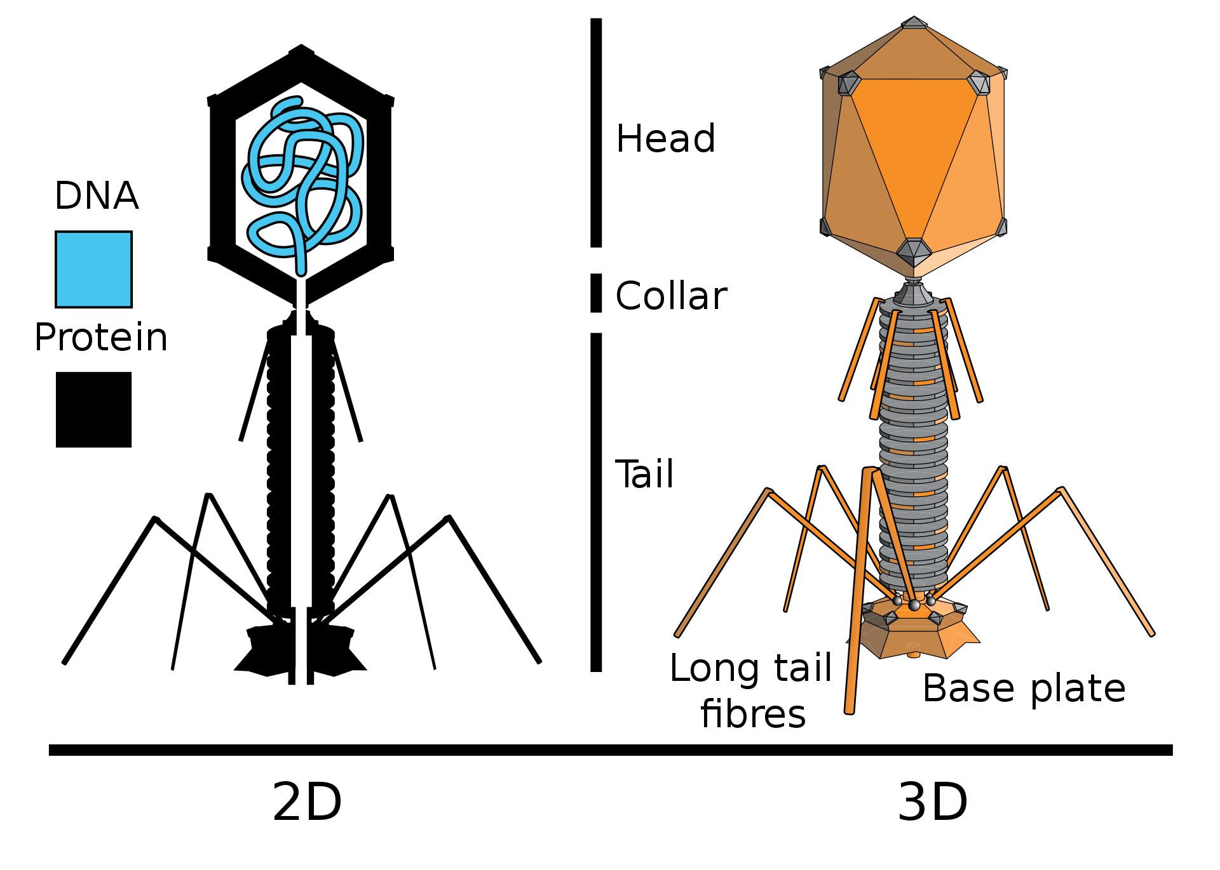
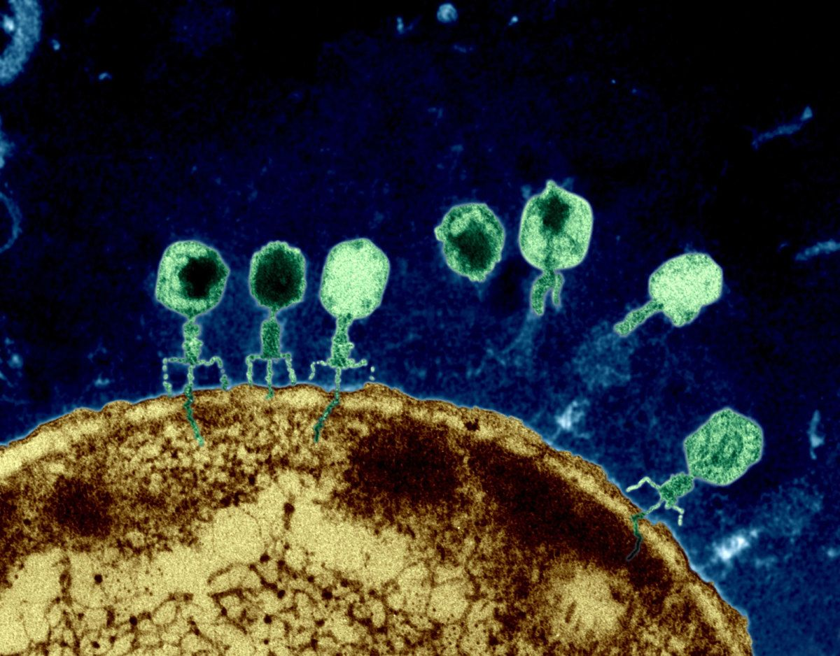
PHAGES
A Bacteriophage or a “phage” is a virus that infects bacteria.
Extremely abundant, estimated to be ~10³¹ bacteriophages on the planet, more than every other organism (including bacteria) combined.
3 types classified based on life cycle:
  Lytic
  Temperate
  Chronic
Notes:
In the lytic cycle, bacteria cells are lysed immediately upon replication of the virus.
In lysogenic cycle, (latent phase) the phage’s DNA is incorporated into the bacteria’s genome where it remains latent until it is induced to replicate. (vertical gene transfer)
In chronic infection, phages can replicate without lysing the bacteria (horizontal gene transfer)

Slide 4
GOAL
MODEL THE BACTERIOPHAGE LIFE CYCLE TO INVESTIGATE THE SYNERGY BETWEEN PHAGE AND ANTIBIOTIC TREATMENT FOR THE CONTROL OF PSEUDOMONAS AERUGINOSA
Notes:
no mathematical models of bacteria-phage interaction have analyzed the competition between temperate and chronic phage strategies in an environment with pulses of antibiotic stress, as would happen during treatment. Filling this knowledge gap is critical to understanding the impact of antibiotic treatment on a patient infected with the bacterium P. aeruginosa.

Slide 5
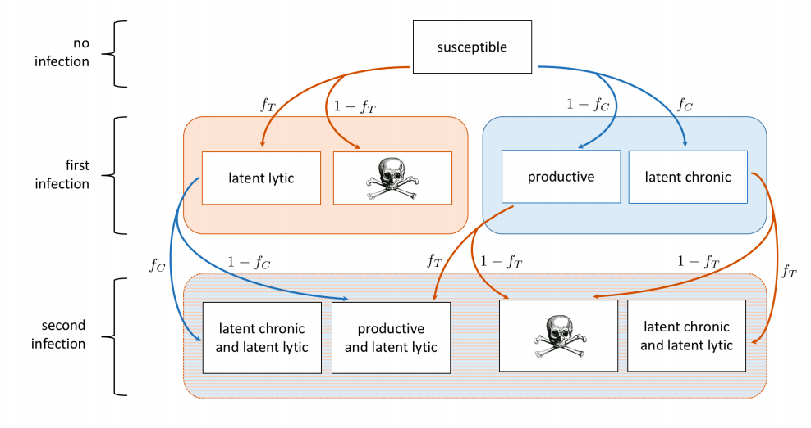
APPROACH OF THE PAPER— bacteriophage system
orange = temperate
blue = chronic
Notes:
a system of two competing types of bacteriophage: one temperate phage VT with lytic and latent lytic stages, and one chronic phage VC with productive and latent stages
FIG. 1. Flowchart of bacteria-phage system with both temperate (orange) and chronic (blue) phages. Boxes indicate a bacterial state, and arrows indicate an infection by phage. If a bacterium is infected by temperate phage, the probability of going latent lytic is fT . If a bacterium is infected by chronic phage, the probability of becoming latent chronic is fC .

Slide 6

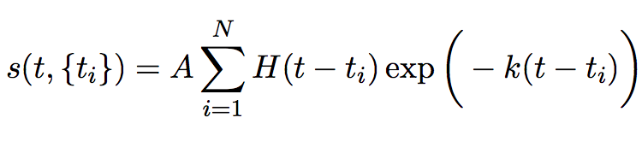
APPROACH OF THE PAPER— infected system
The rate of infection is modeled using Michaelis-Menten kinetics
V = phage, B = bacteria, h_n = bacteria population at which infection rate is at half-max
The stress on the system via antibiotics dosing is modeled using an exponential decay system
t = time, {ti} = list of antibiotic does times, A = amplitude of stress caused by a single dose, N = number of total antibiotic doses, H = heaviside function, k = rate of decay of antibiotics in the system

Slide 7

APPROACH OF THE PAPER— response of the infected system
When the system is stressed, three possible responses may occur
Bacteria susceptible to the antibiotics die, and bacteria resistant to antibiotics will not
Bacteria infected with temperate phage will induce phage production at rate equal to the amount of stress on the system
Productive bacteria increase phage production and decrease reproduction. This increase in phage production is modeled with a functional response
s = stress level, B_c = phage production under no stress, B_max = maximum phage production, h_B = stress level at which the phage production is halfway between minimum and maximum

Slide 8
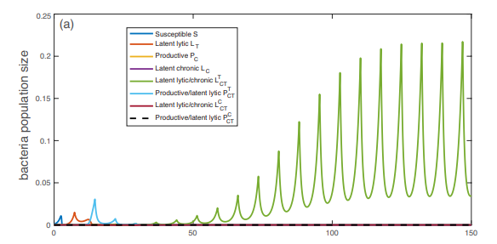

FIGURE OF INTEREST (Original)

Slide 9
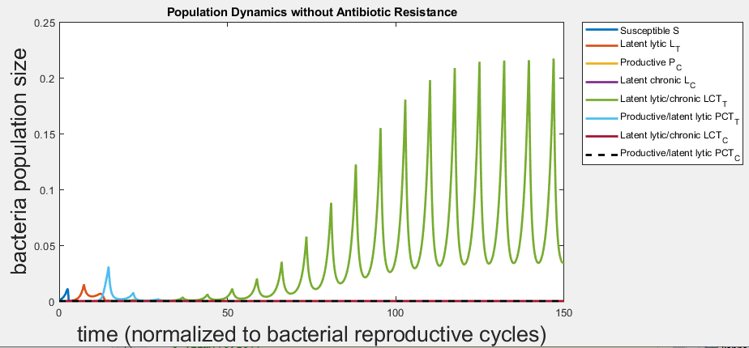
FIGURE OF INTEREST (Recreated)
Time is normalized by bacterial reproduction rate (7.3 bacterial reproduction cycles = 1 day)
50 BRCs = 6.8 days
Drug is administered once a day.

Slide 10
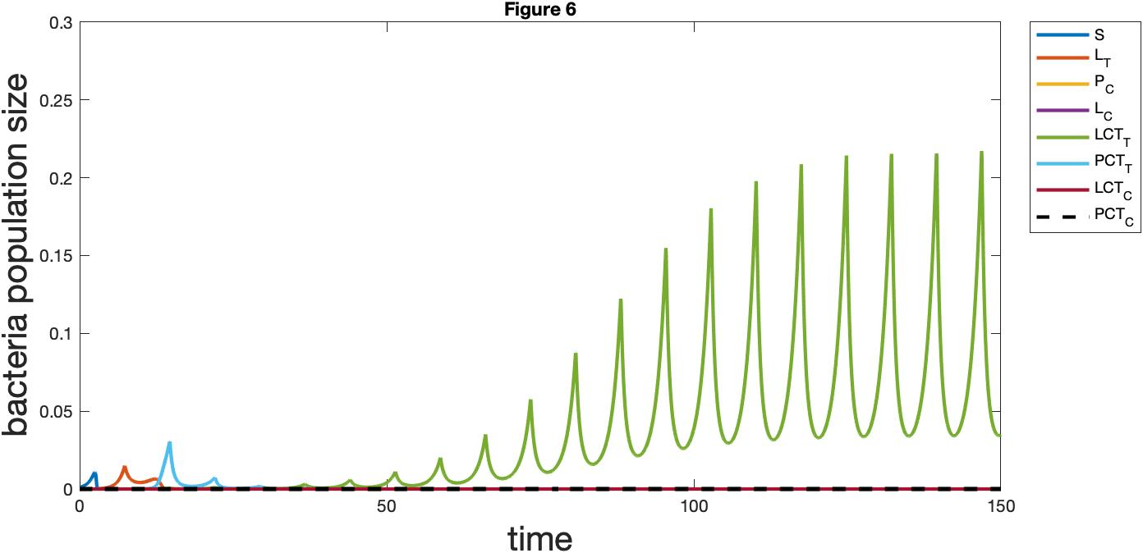
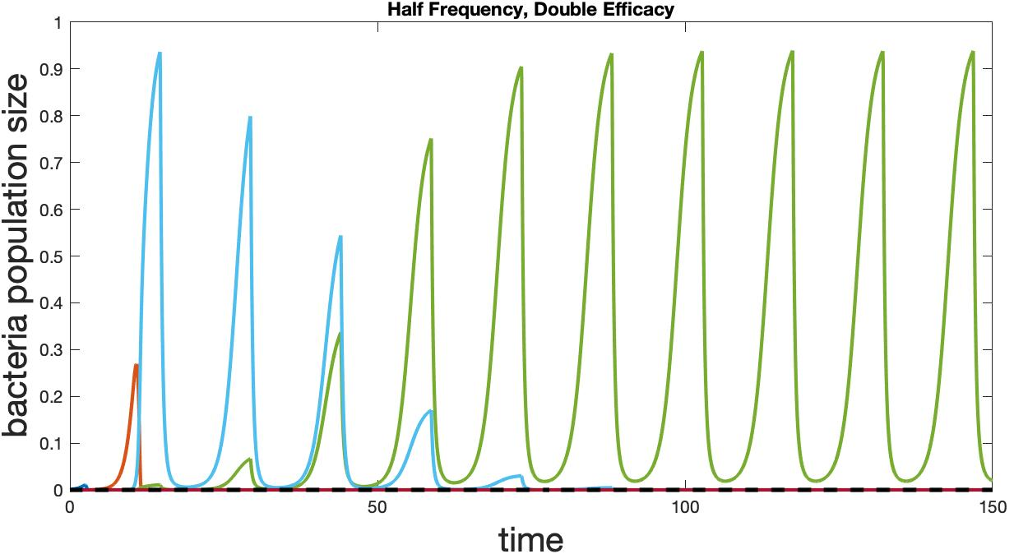
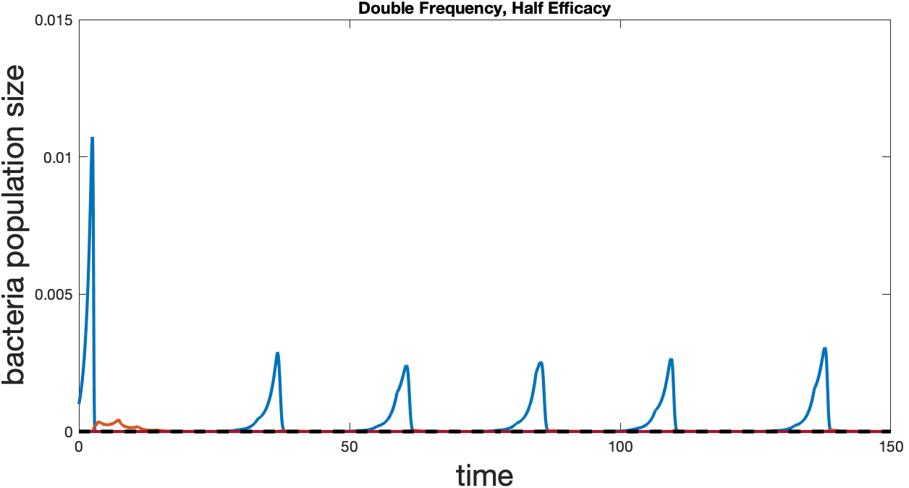
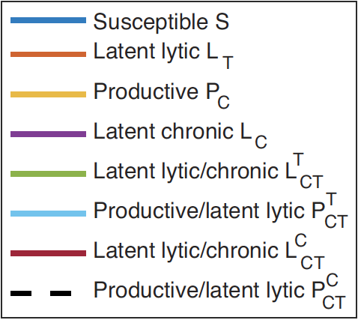
NOVEL APPROACH: Effect of Frequency & Efficacy of Antibiotics?
Notes:
Normal = over population approx 0.22, latent lytic/chronic dominates
half frequency = larger population, see less frequency, steeper oscillations due to higher efficacy and less frequent dosing
Double frequency = smaller overall population (0.005) Susceptible bacteria dominates…. why tho

Slide 11
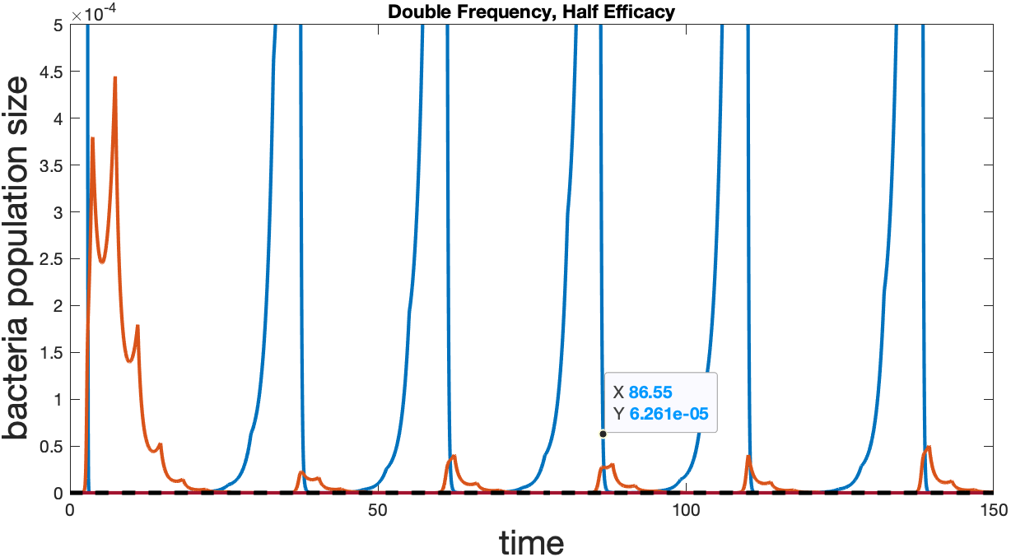
NOVEL APPROACH: 2x Frequency, Half Efficacy
Notes:
-Get rid of the point on the figure
Why susceptible dominating population?
In other graphs we see red (latent lytic), then light blue (productive/latent lytic), then green (latent lytic/chronic)
Zoom & see here that red (latent lytic) rises, but then is snuffed out by antibiotics before the light blue (productive/latent lytic) population can arise. Why does susceptible dominate still?
…”with each dose the productive bacteria are replaced with strains doubly infected by latent phage, which eventually dominate the system. This phenomenon occurs because most bacteria that are latently infected with temperate virus respond to antibiotic stress by inducing lysis, which brings the number of bacteria to a very low number” The drop in bacterial population allow the doubly latent infected bacteria (unencumbered by phage production) to grow slightly faster than productive bacteria and dominate the system.

Slide 12
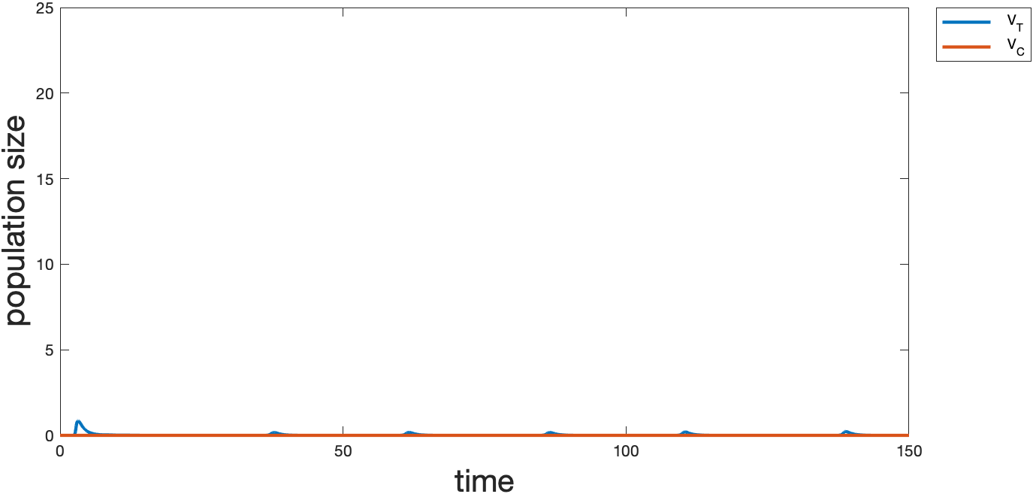
NOVEL APPROACH: Adjust Frequency & Efficacy of Antibiotics
Notes:
Susceptible dominates because the phage does not have time to reproduce here to infect the bacteria
-Need to put the y axis in perspective - compare to others
- Add title to graph

Slide 13
Thank you!
Questions?

Slide 14
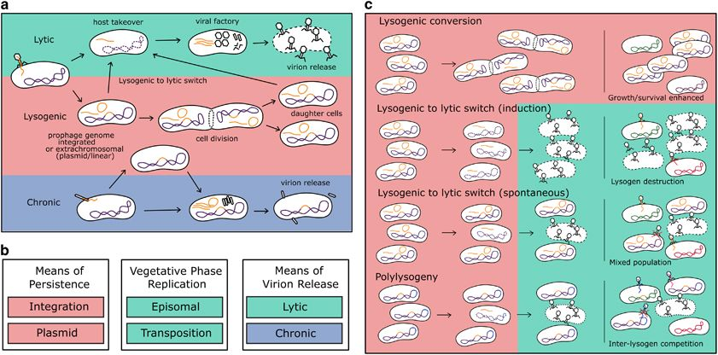

Slide 15
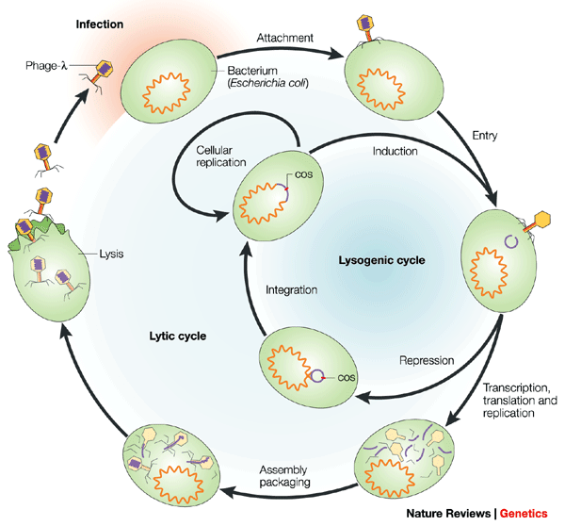
USING PHAGES TO CONTROL BACTERIAL INFECTIONS
In the 1920s and 1930s research was done in the Soviet union on phage therapy for bacterial infection
They had widespread use and success, but upon the invention of antibiotics, research was discontinued.
Today as antibiotic resistance becomes a greater problem, new research in phage therapy for resistant infection.
Phage therapy when coupled with antibiotics has been shown to improve treatment whether or not the infection is resistant to antibiotics
  Takes advantage of the environmental stress that the antibiotic places on the bacteria. Even for resistant bacteria, this stress can be enough to trigger a switch to a lytic cycle, thereby controlling the population of the bacteria.
Notes:
In the lytic cycle, bacteria cells are lysed immediately upon replication of the virus.
In lysogenic cycle, (latent phase) the phage’s DNA is incorporated into the bacteria’s genome where it remains latent until it is induced to replicate. (vertical gene transfer)
In chronic infection, phages can replicate without lysing the bacteria (horizontal gene transfer)

